Slide 1
3D AR USING
GESTURE RECOGNITION
PRESENTED BY ARUZHAN, ALTYN

Slide 2
INTRODUCTION
Our project showcases an interactive augmented reality (AR) system that uses real-time hand gestures for digital drawing, 3D object manipulation, and gallery navigation. Built with Python, the application integrates MediaPipe for gesture tracking, OpenCV for camera input, PyOpenGL for rendering 3D objects, and Pygame for canvas and display management. Users can control the system entirely through natural hand movements, making it a hands-free, intuitive platform for creative expression and spatial interaction. The modular design allows smooth transitions between drawing, 3D, and gallery modes, highlighting the potential of AR in education, digital art, and rehabilitation.

Slide 3
To create an interactive AR environment that uses hand gestures to draw and manipulate 3D objects in real time we use:
OpenCV – handles camera input and video processing. Reading a video file requires processing each frame individually, and then displaying or storing it as needed. OpenCV provides the VideoCapture() function for this purpose, allowing users to load video files and access webcam streams in real-time
2. MediaPipe – for hand and face landmark detection. It works by using machine learning models to detect and track features like hands, faces, or poses in real-time from video or image input. It processes visual data through a graph-based pipeline that efficiently handles input preprocessing, model inference, and post-processing.

Slide 4
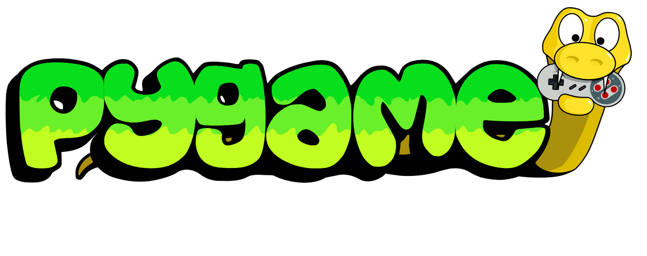
Pygame is a cross-platform, open-source Python library that facilitates the creation of 2D games. It provides modules for handling graphics, sound, and user input, simplifying the game development process.
In our project:
Managing OpenGL Window: Pygame initializes and manages the OpenGL window, ensuring that the graphics are drawn within a properly configured window environment.
Handling Real-Time Events: Pygame listens for real-time events like key presses, mouse movements, and quit events. This allows for user interaction during the session (e.g., switching between 3D shapes or exiting the application).
Display Refreshing: Pygame controls the display refresh at the correct frame rate, ensuring smooth visual updates.

Slide 5
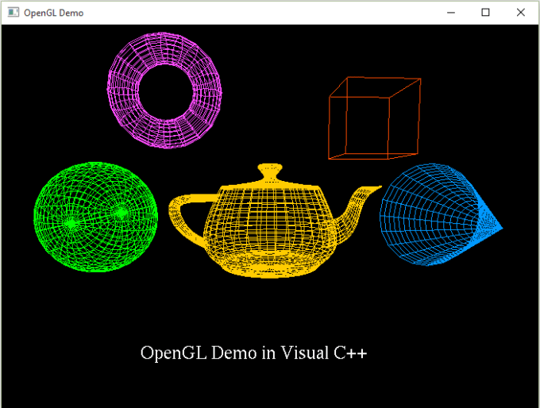
OPENGL
OpenGL (Open Graphics Library) is a cross-platform, hardware-independent API (Application Programming Interface) that is used to render 2D and 3D graphics. It provides a set of functions and tools that allow developers to interact with the graphics hardware to create visually rich applications, such as video games, simulations, or visualizations. OpenGL handles tasks like drawing shapes, applying textures, lighting effects, and transforming objects within a 3D space

Slide 6
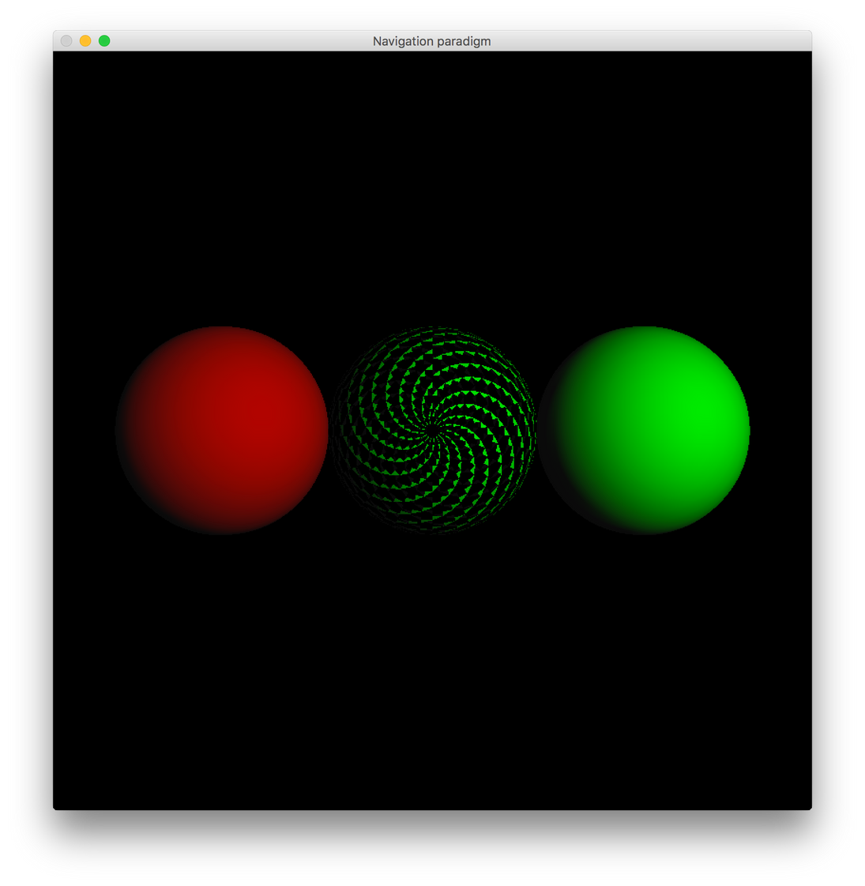
PYOPENGL
PyOpenGL is a Python binding for OpenGL, allowing Python developers to access and use OpenGL's functionality in their applications. With PyOpenGL, you can leverage the full power of OpenGL’s 2D and 3D graphics capabilities directly from Python code. This makes it easier to integrate graphics programming into Python projects, especially when combined with other libraries like Pygame or PyQt for handling windows, events, and user interaction. Essentially, PyOpenGL acts as a bridge between Python and OpenGL, enabling Python developers to harness the graphical power of OpenGL in a familiar programming environment.

Slide 7
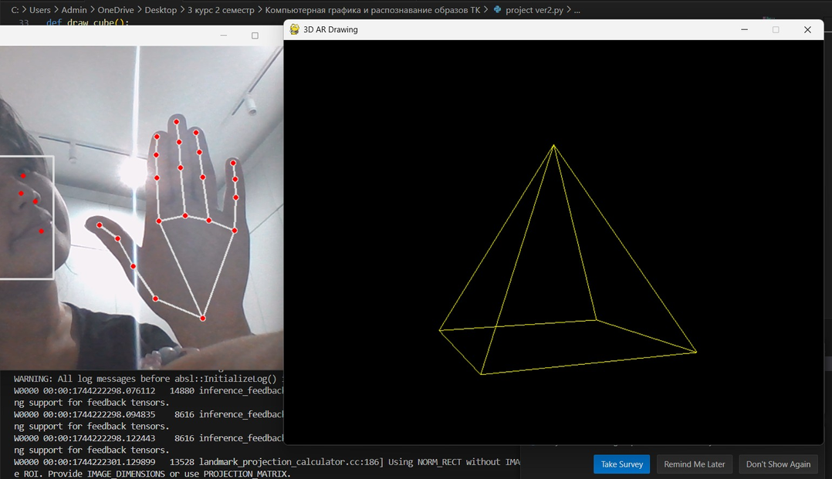
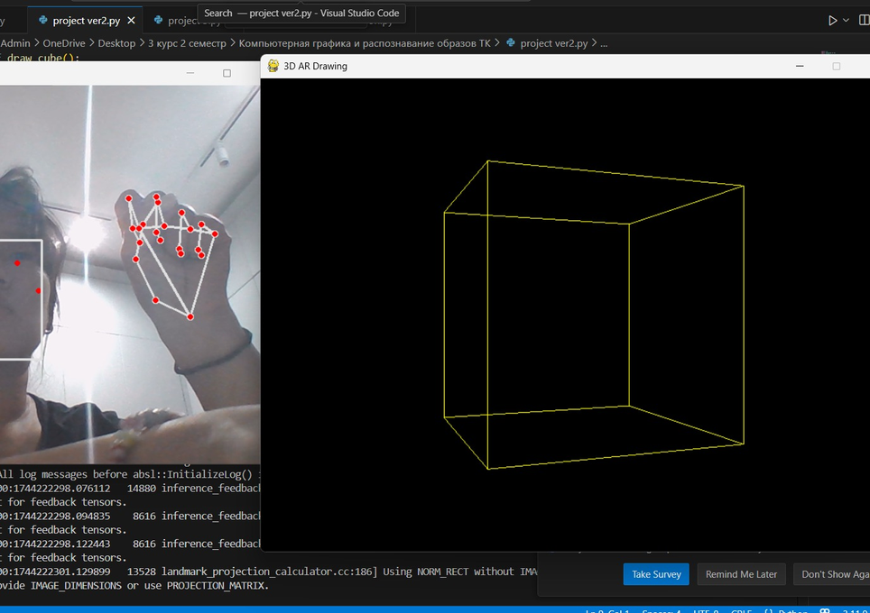
HOW IT WORKS?
We uses OpenGL's glBegin() and glVertex3fv() functions to render various 3D shapes such as cubes, pyramids, and spheres. Each shape is defined by a set of vertices, which are connected by edges to form a wireframe. These shapes are drawn in 3D space by specifying their vertices (coordinates) and using OpenGL to connect these vertices with lines or surfaces. The glBegin() function initializes the shape to be drawn, while glVertex3fv() specifies the positions of each vertex in 3D coordinates. The shapes are then rendered on the screen with appropriate colors and visual details, contributing to the interactive AR experience.

Slide 8
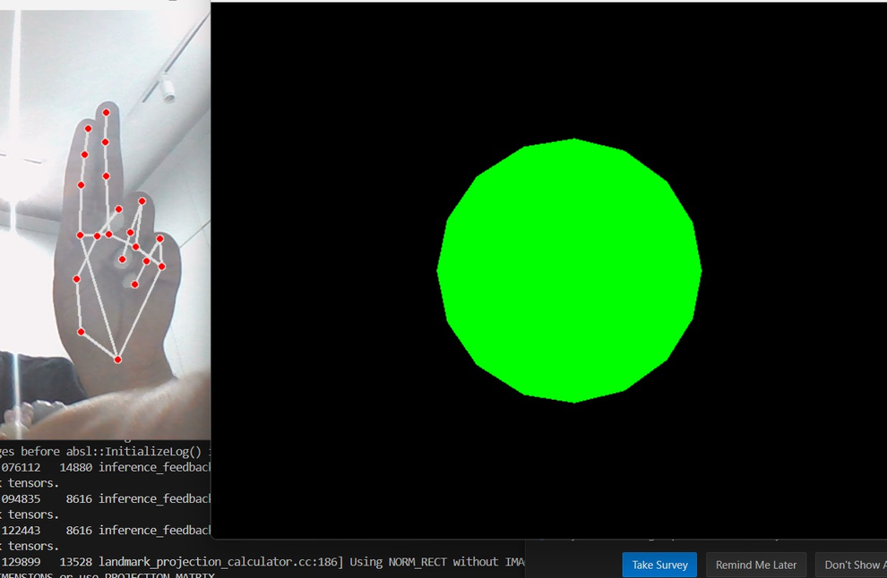
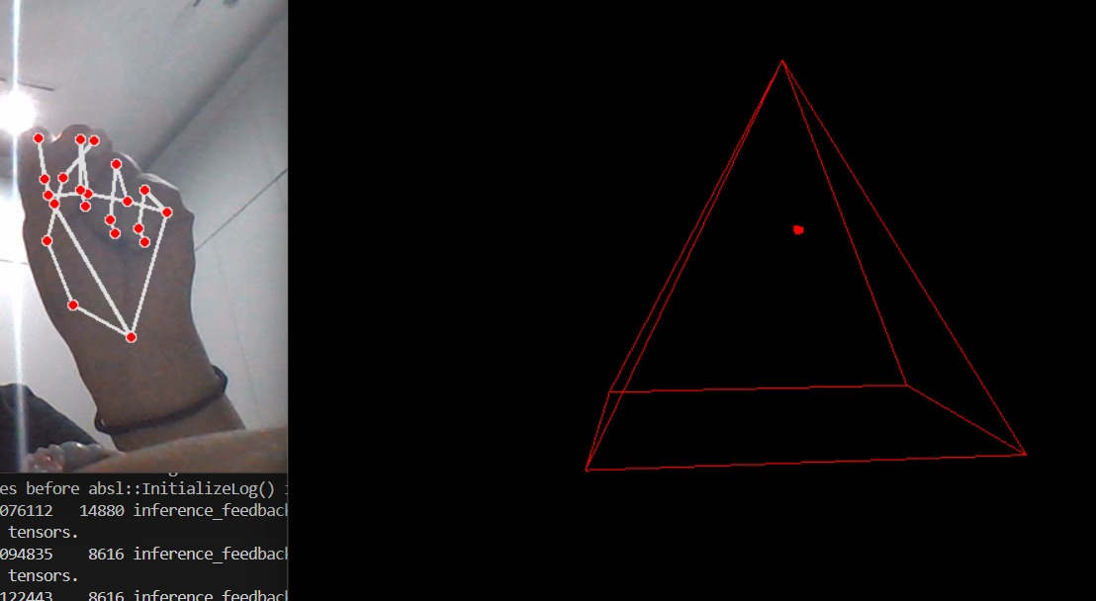
ROTATION & PERSPECTIVE
To enhance the 3D environment, we appliy transformations such as rotation and perspective adjustments. The glRotatef() function is used to rotate the shapes along specific axes, giving the illusion of objects moving or spinning within the 3D space. By updating the rotation values continuously, the project allows for a dynamic visual experience where objects appear to rotate based on user interactions.
Additionally, gluPerspective() is used to apply a perspective projection, ensuring that objects in the 3D environment are displayed with a sense of depth and distance. This is crucial for creating a natural 3D effect, where objects closer to the viewer appear larger, and those further away appear smaller, simulating real-world visual perception.

Slide 9
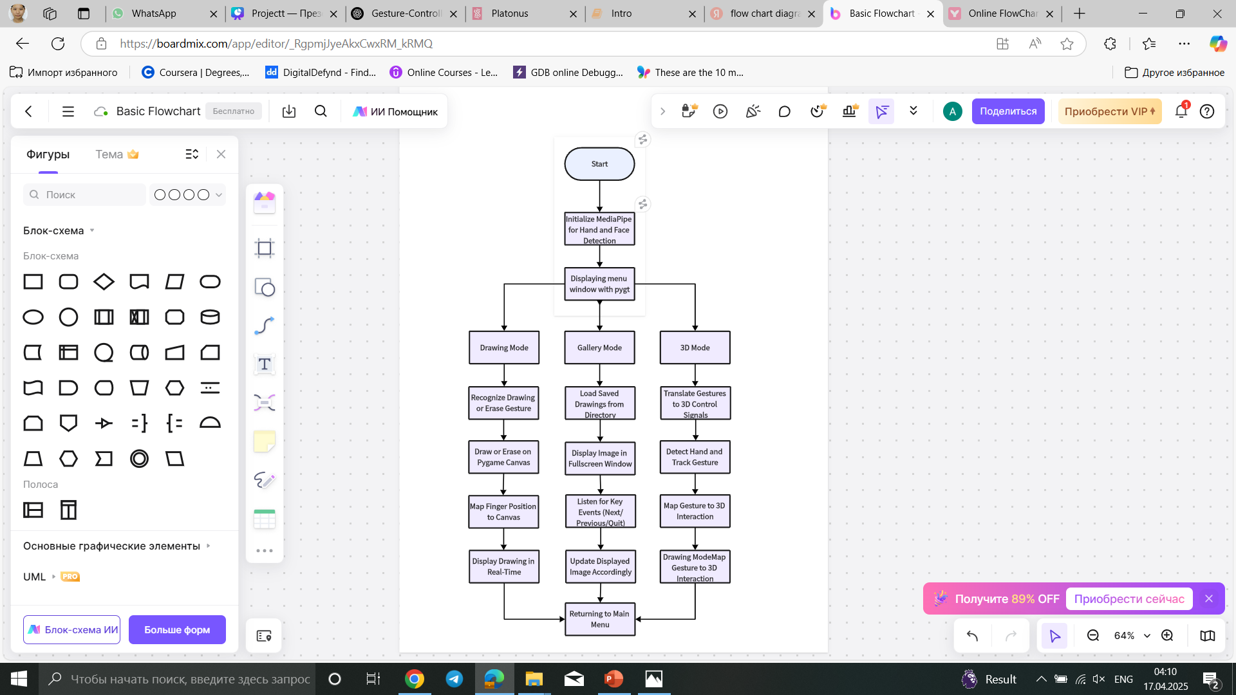
SYSTEM ARCHITECTURE
The system operates based on real-time input from a webcam, processed via MediaPipe for hand and face detection.
Drawing mode
In Drawing Mode, the application captures live webcam input and processes hand landmarks to enable intuitive gesture-controlled digital painting. This is built on top of the Pygame rendering environment.
Gallery mode
Gallery Mode is designed for reviewing previously saved work in a fullscreen viewer. Implemented using Pygame, it acts as a lightweight image browser.
3D mode
3D Mode showcases the use of OpenGL in conjunction with gesture control for rendering and manipulating 3D shapes. It creates an immersive visual experience that blends virtual geometry with user-driven input..

Slide 10
CONCLUSION
In conclusion, in this project we successfully use real-time hand gesture recognition with 3D object rendering, creating an immersive and intuitive augmented reality experience. By leveraging MediaPipe for gesture detection and OpenGL for 3D rendering, users can interact with virtual objects in a natural way, drawing and manipulating shapes in mid-air. The system’s ability to respond to hand movements in real-time, coupled with gesture-based controls for switching shapes and clearing paths, ensures a fluid and dynamic interaction. Lastly, we demonstrate the potential of combining computer vision and 3D rendering to create innovative and engaging user experiences in augmented reality.

Slide 11
THANK YOU!

